Slide 1

GraalVM Native Images With Java 17
Paul G. Allen, MSSE

Slide 2
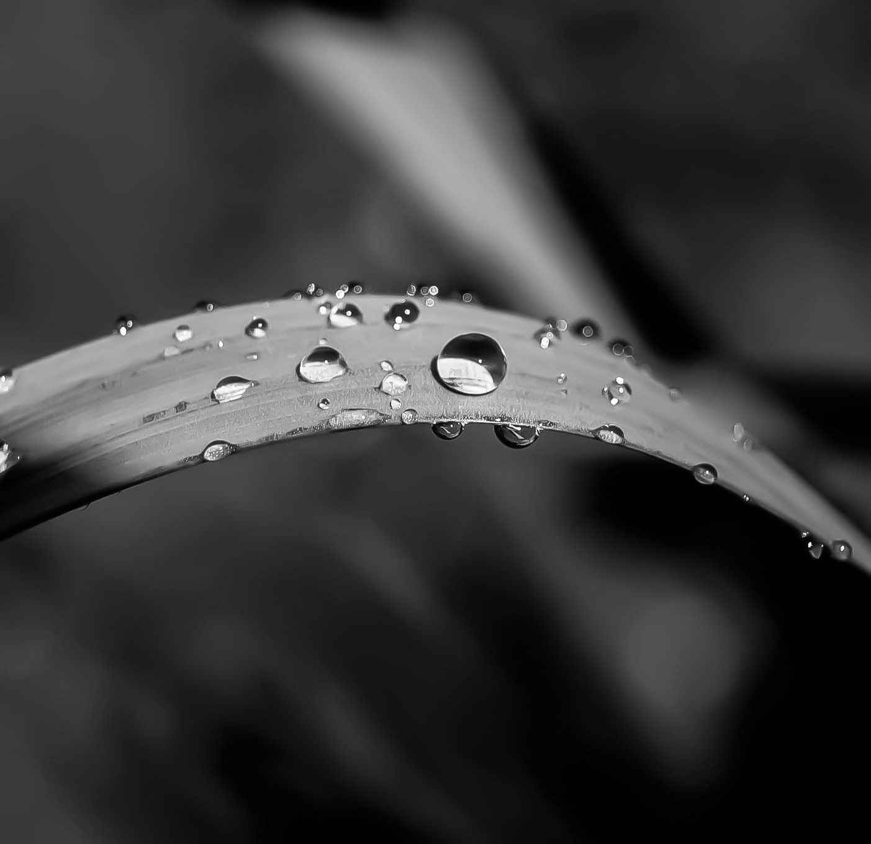
Contents
Introduction
Java 17 Overview
GraalVm Overview
Native Images
Process
Native Image Conversion
References

Slide 3
Introduction

Slide 4
Introduction
Author
SW Engineer for more than 30+ years (commercial, contractor)
Java Engineer for 15+ years (commercial, contractor)
HW engineer for 10+ years (commercial, contractor)
Systems Engineer for 10+ years (commercial, contractor)
UNIX Administrator for 10+ years (commercial, contractor)
Cybersecurity since before it was a term (commercial, contractor)
Working with Oracle Technologies for 5 years (Java, WebLogic, oracle DB)
Working with cloud for 2 years (Azure, private cloud)
Working with containers for 1 year (Docker, Kubernetes)
Oracle sponsored Java 17 webinar including focus on GraalVM in 2021

Slide 5
Introduction (Cont)
Technology
The “Cloud” has taken a hold on the industry
The cloud and high-speed internet enabled microservices
Containers enabled better microservice management
Microservices caused resource usage to explode
These technology changes increased security risks
Solutions were needed
Java 17 tightens security and improves performance
GraalVM further tightens security and improves performance

Slide 6
Java 17 Overview

Slide 7
Java 17 Overview
Relevant Features
Container Aware
New Garbage Collectors
Security Improvements
1%-8% Faster Code Execution
CDS Archive Changes for Faster JVM Startup
Improved GraalVM Compiler

Slide 8
Java 17 Overview (Cont)
JEP Implementations
JEP 353: Reimplement the Legacy Socket API
*JEP 372: Remove the Nashorn JavaScript Engine
JEP 396: Strongly Encapsulate JDK Internals by Default
JEP 403: Strongly Encapsulate JDK Internals
*JEP 411: Deprecate the Security Manager for Removal
Garbage Collectors
G1 (default, reduced pause times)
ZGC (even lower pause times)
Shenandoah (pause time independent of heap size)
No-Op (memory profiling)

Slide 9
GraalVM Overview

Slide 10
GraalVM Overview
Creation
Oracle Labs team in Switzerland and Austria
Lead by Thomas Wuerthinger
Ten (10) years in development
Written in Java with goal to support any program in any language
Community Edition and Enterprise Edition
Enhanced security and performance

Slide 11
GraalVM Overview (Cont)
Technology
Written in Java
Easier for developers to modify
Memory-safe
Benefits from Java profiling and debug tools
Polyglot
Java
JavaScript (Node.js)
LLVM (C and C++)
Python
R
Ruby
WASM
Specific language or polyglot (JS, Ruby, R)
Truffle

Slide 12
GraalVM Overview (Cont)
Technology (Cont)
Native Image
No JVM
Native machine language
Fast startup, fast execution, smaller footprint
Compiler
AOT Compiler
JIT Compiler

Slide 13
GraalVM Overview (Cont)
Features/Enhancements
Up to 100 times faster startup
Eliminates the virtual machine (JVM)
Applications need not be in an idle state
Less memory
No JVM == smaller footprint
No JVM == fewer computational resources used
Native image

Slide 14
Native Images

Slide 15
Native Images
What is it?
Takes Java bytecode as input and creates a binary executable as output
No JVM unless using a fallback file (more later)
Features
No JVM == smaller memory footprint
No JVM vulnerabilities (e.g. – no vulnerable String types)
Machine language == faster sustained performance
Use a fraction of the resources required by the JVM, so cheaper to run
Starts in milliseconds
Deliver peak performance immediately, no warmup
Can be packaged into lightweight container images for faster and more efficient deployments
Reduced attack surface

Slide 16
Native Images (Cont)
Pros
Fewer resources needed
More secure
Better container support
30% - 50% better performance
Up to 90% smaller images
No need to keep a microservice in an idle state
Cons
Breaks the “Write once, run anywhere” mantra
Longer compile time
More complex build process
No run-time optimization
No JVM

Slide 17
Process Overview

Slide 18
Process Overview
Java 17 Upgrade
Baseline
Build and test stable release
Unit tests
Full regression test if needed
Update to Java 17
Update JDK
Compile
Address failures
Repeat 2B
Test
Unit test
Regression test
Repeat from 2B as needed
Stable Java 17 Complete

Slide 19
Process Overview (Cont)
Create Native Image
Full test with tracing agent
Unit test if possible
Regression test
Manual test
Build native image
Build non-container image
Address failures
Repeat Java 17 build Step 2B

Slide 20
Process Overview (Cont)
Test Native Image
Unit test if possible
Regression test
Manual test
Complete Stable Native Image
Create Docker Image
Two stage or single stage image build?
Two stage for different target architecture
Single stage if same target architecture
System Test container

Slide 21
Native Image Conversion

Slide 22
Native Image Conversion
Background
Closed-world Assumption
All code is known at build time
No new code is loaded at run time
No JVM is normally used
A fallback file may be produced if compiler can’t optimize the image
A fallback requires a JVM to run (not a native image)
Compiler can be told not to generate a fallback file
All reachable code must be known at build time

Slide 23
Native Image Conversion (Cont)
Background (Cont)
JVM initializes classes at first use
JVM includes Jar files from the classpath that may never be used
NI does not use a JVM
All classes and resources are compiled into a binary image
NI initializes classes at build time
All static state is compiled at stored at image build time
Frequently used classes such as java.lang.String
Using command line option --initialize-at-build-time=<class>
From a configuration file
Static Analysis
Class bytecode scanned for reachable code
Method bytecode scanned for reachable elements
Discovered elements scanned iteratively
Only reachable elements are included in the final image

Slide 24
Native Image Conversion (Cont)
Detailed Build Process
Prerequisites
Start with a known stable Java 17 release of app to be built
GraalVM compiler version 22.2.r17 (sdkman 22.2.r17-grl)
Graal Updater (for tracing agent) installed
IDE with debugger support (optional, but very helpful)
Step 1 – Starting point, test compile and run
Example basic build command for Qpid
native-image --no-fallback -J-XX:MaxDirectMemorySize=1536m -J-server -Dpolyglot.js.nashorn-compat=true -DPNAME=QPBRKR -DQPID_HOME=/usr/local/src/qpid/Qpid4Graal/native/qpid-broker/8.0.6 -DQPID_WORK=/var/qpidwork -jar qpid-broker-8.0.6.jar qpid
Execute the resulting image
./qpid –DPNAME=QPBRKR –DQPID_HOME=/var/local/qpid –DQPID_WORK=/var/qpidwork –st JSON
On failure, valuable insight is provided
What command line options are needed
What issues need to be resolved
Is it even worth doing

Slide 25
Native Image Conversion (Cont)
Detailed Build Process (Cont)
Step 2 – Debug and Agent Test
2a: Debug and address any obvious failures
Add native-image command line options as needed
HTTP Protocol
HTTPS Protocol
Signal Handlers
Correct obvious code issues
Review the Native Image Compatibility Guide
Review Spring Native Image Documentation
Add missing resources to the build/image path
Database driver(s)
Locale bundle(s)
Property files
Manifest file (Main class)

Slide 26
Native Image Conversion (Cont)
Detailed Build Process (Cont)
Step 2 – Debug and Agent Test
2b: Run the Tracing Agent
Purpose
Tracks resources and classes used at run time
Creates/updates configuration files as needed for build time
Requires Java run-time testing
Install the tracing agent using the GraalVM Updater
Run the Java application with the tracing agent:
Via command line:
java -agentlib:native-image-agent=config-merge-dir=${BUILDPATH}/src/main/resources/META-INF/native-image -server –classpath <CLASSPATH> -Dpolyglot.js.nashorn-compat=true -DPNAME=QPBRKR -XX:+HeapDumpOnOutOfMemoryError -Xmx512m -XX:MaxDirectMemorySize=1536m -DQPID_HOME=/usr/local/src/qpid/Qpid4Graal/native/qpid-broker/8.0.6 -DQPID_WORK=/var/qpidwork org.apache.qpid.server.Main -st BDB
Via environment variable
export JAVA_TOOL_OPTIONS="-agentlib:native-image-agent=config-merge-dir=${BUILDPATH}/src/main/resources/META-INF/native-image“
Execute system tests
Stop the application to save configuration

Slide 27
Native Image Conversion (Cont)
Detailed Build Process (Cont)
Step 3 – Repeat the build-run-test process
Verify the native image configuration files
Build the native image
System test the image
Repeat Step 2 and 3 as needed

Slide 28
Native Image Conversion (Cont)
Maven build
Typical
Set Java version to 17
Add dependencies:
<!-- TODO: Remove when GraalVM engine support is working. -->
<dependency>
<groupId>org.openjdk.nashorn</groupId>
<artifactId>nashorn-core</artifactId>
<version>15.4</version>
</dependency>
<!-- TODO END -->
<!-- Java 17 GraalVM compiler and JavaScript engine -->
<dependency>
<groupId>org.graalvm.compiler</groupId>
<artifactId>compiler</artifactId>
<version>22.2.0</version>
</dependency>
<dependency>
<groupId>org.graalvm.js</groupId>
<artifactId>js</artifactId>
<version>22.2.0</version>
</dependency>
<dependency>
<groupId>org.graalvm.js</groupId>
<artifactId>js-scriptengine</artifactId>
<version>22.2.0</version>
</dependency>
<!-- END Java 17 GraalVM and JavaScript engine -->

Slide 29
Native Image Conversion (Cont)
Maven Build (Cont)
Spring Boot
Dependencies for native image
Unit tests may not be supported
<!–- Migrator is for development/debugging only -->
<dependency>
<groupId>org.springframework.boot</groupId>
<artifactId>spring-boot-properties-migrator</artifactId>
<scope>runtime</scope>
</dependency>
<dependency>
<groupId>org.springframework.experimental</groupId>
<artifactId>spring-native</artifactId>
<version>0.12.0</version>
</dependency>

Slide 30
Native Image Conversion (Cont)
Maven Build (Cont)
Spring Boot (Cont)
Build plugins for native image
<build>
<plugins>
<plugin>
<groupId>org.springframework.experimental</groupId>
<artifactId>spring-aot-maven-plugin</artifactId>
<version>0.12.0</version>
<executions>
<execution>
<id>generate</id>
<goals>
<goal>generate</goal>
</goals>
</execution>
<execution>
<id>test-generate</id>
<goals>
<goal>test-generate</goal>
</goals>
</execution>
</executions>
</plugin>
<plugin>
<groupId>org.springframework.boot</groupId>
<artifactId>spring-boot-maven-plugin</artifactId>
<executions>
<execution>
<goals>
<goal>build-image</goal>
</goals>
</execution>
</executions>
<configuration>
<image>
<builder>paketobuildpacks/builder:tiny</builder>
<env>
<BP_NATIVE_IMAGE>true</BP_NATIVE_IMAGE>
</env>
<name>${NATIVE_IMAGE_NAME}</name>
</image>
</configuration>
</plugin>
</plugins>
</build>

Slide 31
Native Image Conversion (Cont)
Common Build Issues
Reflection and Proxies
Review Understanding Reflection and GraalVM Native Image
Random class names (Derby)
Entry Point
Missing Manifest.MF file
Missing entry point in Manifest.MF
Manifest.MF not in application path
Resources
No classpath in a native image
No JAR files
Resources must be in the application search path
External library/driver support
Unit Tests (Junit)
Some Junit libraries may not be supported

Slide 32
Native Image Conversion (Cont)
Maven
Gradle
Common Build Issues
Reflection and Proxies
Review Understanding Reflection and GraalVM Native Image
Random class names (Derby)
Entry Point
Missing Manifest.MF file
Missing entry point in Manifest.MF
Manifest.MF not in application path
Resources
Spring Framework and Spring Boot
Unit Tests (Junit)

Slide 33
References

Slide 34
References
Forbes: Meet the Team that Built GraalVM, an Energy-Saving Multi-Lingual Compiler Written Entirely in Java
GraalVM
GraalVm v22.2 Reference Manuals
Java 17 Features: A comparison between versions 8 and 17. What has changed over the years?
Native Image Compatibility Guide
OpenJDK JEP Index
Qpid GraalVM Project
Spring Native Image Documentation
Understanding Reflection and GraalVM Native Image

